Slide 1
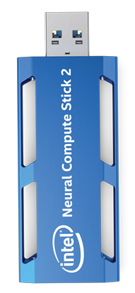
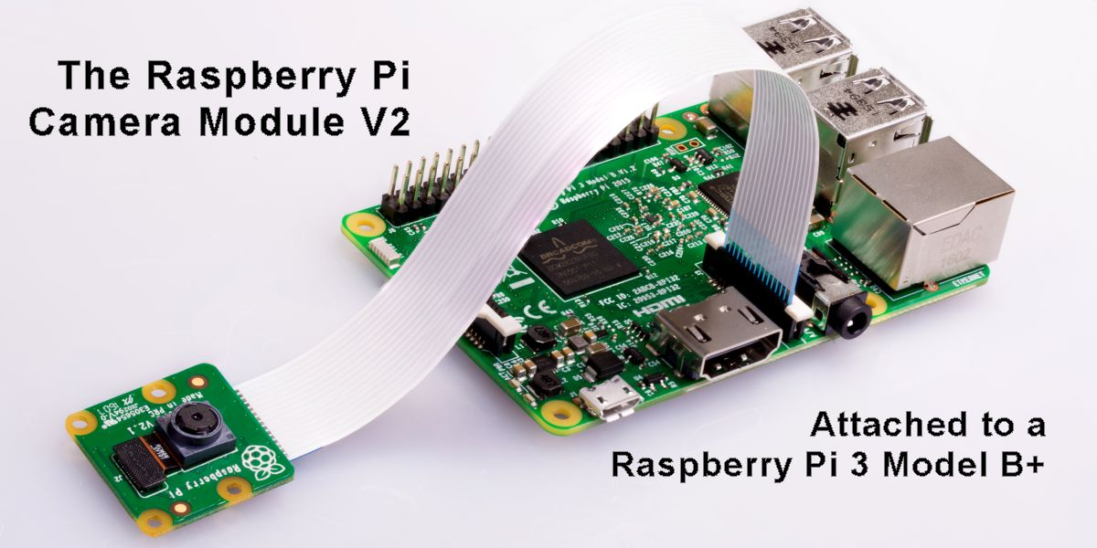
Real-Time Detection System for Multiple Fruits Using Raspberry Pi

Slide 2
Introduction
Agricultural modernization is an unstoppable trend.
Real-time fruit detection can enhance farming efficiency.
Proposal to develop a fruit detection system using Raspberry Pi and YOLOv5
Hardware Components:
Raspberry Pi (for real-time processing).
Intel Neural Compute Stick 2 (for inference acceleration).
Camera module (for capturing images).
Software Components:
YOLOv5 for object detection.
OpenCV for image processing.
Python for system implementation and React js for front end.
Flask/FastAPI (optional) – If serving the model via API.
Node.js & React.js – If building a web-based interface.

Slide 3
Hate Speech Detection with Low Resource Languages
Hate Speech Detection : Low Resource Languages
Sentiment analysis
Hate Speech Detection

